Slide 1
Ingredients and Features of Recipes
An Investigation of
Chinese Recipe Website Xiachufang
Hanbo Shao

Slide 2
Top 10 Dishes
Dishes | Number of Attempts | Rating | Category
Chicken Wings with Coke | 68706 | 8.2 | Chicken
Sweet & Sour Pork Ribs | 36799 | 8.7 | Pork
Pork Ribs with Rice | 24704 | 8.6 | Pork
Soy Sauce Braised Pork | 21236 | 8.1 | Pork
Chicken Wings with Coke | 20837 | 8.1 | Chicken
Mapo Tofu | 20806 | 7.8 | Tofu
Soy Sauce Braised Eggplant with Pork | 20204 | 7.9 | Pork
Sweet & Sour Pork Tenderloins | 18632 | 8.0 | Pork
Omelet with Scallion | 18100 | 7.6 | Egg
Fried pork with beans | 16301 | 8.1 | Pork

Slide 3
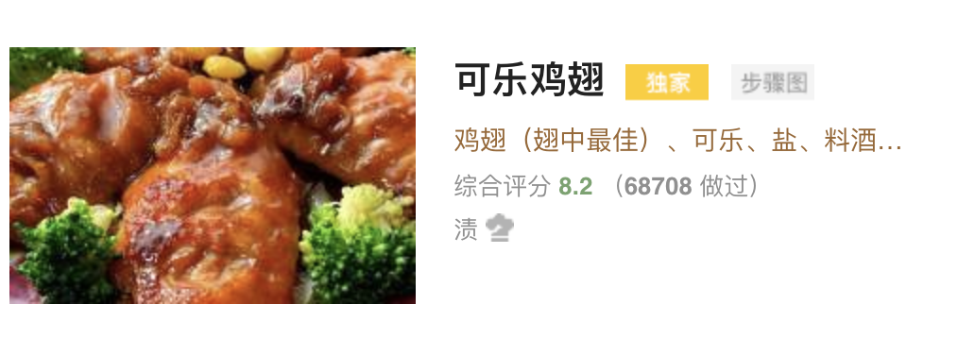
Exclusive
Picture Steps
Xiachufang’s Master Cook

Slide 4
Motivation and Research Questions
How would the exclusive, picture steps, master cook and authors influence the ratings, number of attempts for the recipe and the number of ingredients used in the recipe?
What are the popularities for each major ingredients?
Pork, chicken, beef, lamb, fish, shrimp, egg, tofu
How would the number of ingredients affect the ratings and number of attempts for the recipe?
What are the more common combinations of ingredients?

Slide 5
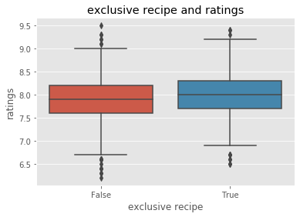
Exclusiveness and ratings

Slide 6
Exclusive Vs. Non-Exclusive
 |  | Number of Attempts |  |  | Ratings |  |  | Number of Ingredients
 | Count | mean | min | max | mean | min | max | mean | min | max
Non-Exclusive | 2245 | 786.53 | 100 | 24704 | 7.89 | 6.2 | 9.5 | 7.20 | 1 | 26
Exclusive | 1000 | 975.21 | 100 | 68706 | 8.02 | 6.5 | 9.4 | 7.58 | 1 | 23

Slide 7
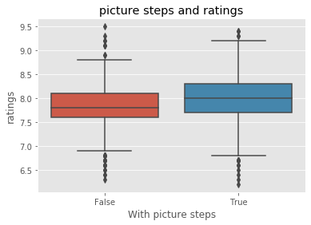
Picture Steps and Ratings

Slide 8
Picture Steps Or Without Pictures
 |  | Number of Attempts |  |  | Ratings |  |  | Number of Ingredients
 | Count | mean | min | max | mean | min | max | mean | min | max
Without Pictures | 982 | 608.42 | 100 | 9976 | 7.82 | 6.3 | 9.4 | 6.95 | 1 | 19
Picture Steps | 2263 | 947.20 | 100 | 68706 | 7.98 | 6.2 | 9.5 | 7.47 | 1 | 26

Slide 9
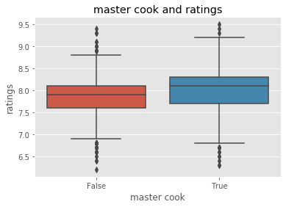
Master cook and ratings

Slide 10
“Master Cook” VS. “Non-master cook”
 |  | Number of Attempts |  |  | Ratings |  |  | Number of Ingredients
 | Count | mean | min | max | mean | min | max | mean | min | max
Non-Master | 2030 | 776.01 | 100 | 36799 | 7.86 | 6.2 | 9.4 | 7.19 | 1 | 23
Master | 1215 | 959.39 | 100 | 68706 | 8.05 | 6.3 | 9.5 | 7.52 | 1 | 26

Slide 11
Authors of the Recipe
 | Number of Attempts | Ratings | Number of Ingredients
Authors of 20 or more recipes | 867.89 | 8.10 | 8.39
Authors of 15 or more recipes | 927.14 | 8.05 | 8.35
Authors of 10 or more recipes | 944.15 | 8.00 | 8.15
Overall Average | 844.68 | 7.93 | 7.31

Slide 12
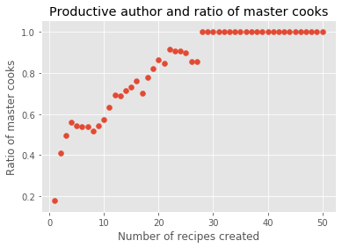
Authors and master cook

Slide 13
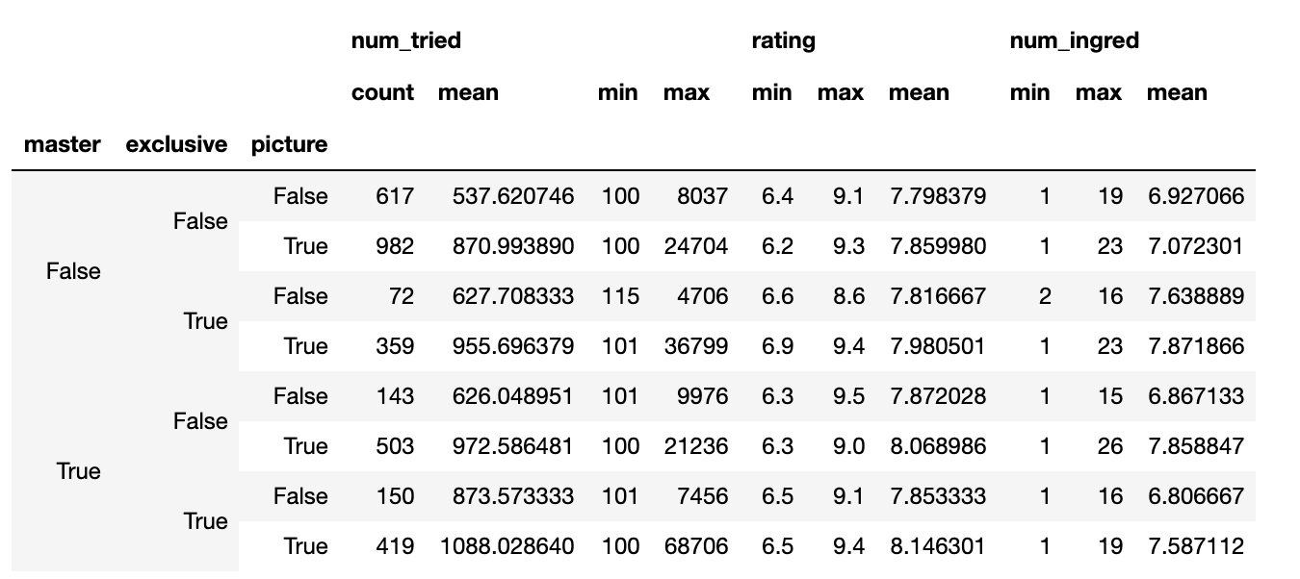
Combining All together

Slide 14
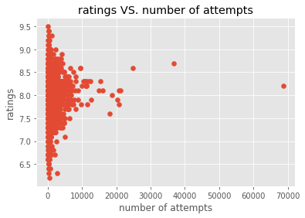
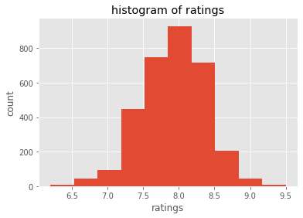
Ratings and Number of Attempts

Slide 15
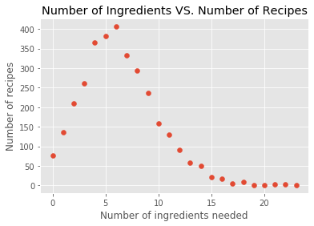
Influence of Number of Ingredients

Slide 16
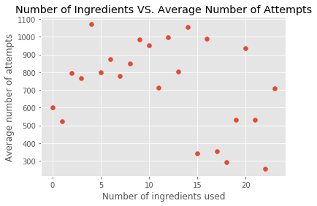
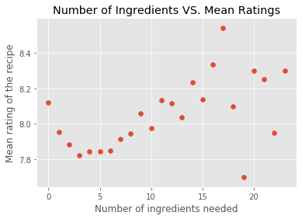
Influence of Number of Ingredients

Slide 17
Popularity of major Ingredients
Ingredients | Count
Pork | 858
Chicken | 762
Beef | 391
Shrimp | 346
Tofu | 330
Egg | 308
Lamb | 144
Fish | 53
Duck | 53

Slide 18
Popularity of other ingredients
Ingredients | Count
Green Onion | 1601
All sorts of Peppers | 1556
Ginger | 1359
Garlic | 1007
Starch | 457
Tomatoes | 321
Carrots | 297
Mushroom | 248
Potatoes | 230
… | …

Slide 19
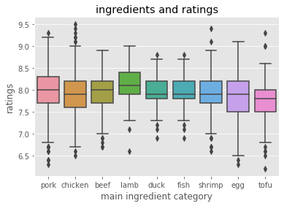
Ingredients and ratings

Slide 20
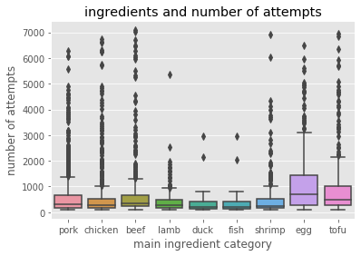
Ingredients and mean number of attempts

Slide 21
Popular combinations
Ingredients | Popular Combinations
Pork | other pork products, noodles, egg
Chicken | other chicken products, potatoes, carrots
Beef | tomatoes, mushrooms, carrots
Shrimp | egg, tomato, mushroom
Tofu | other tofu product, pork, egg
Egg | noodles, other eggs, pork
Lamb | carrots, radish, potatoes
Fish | tofu, mushroom, tomato
Duck | tofu, mushroom, fish

Slide 22
Future work
Statistical analysis of exclusiveness, picture steps and master cooks.
Create a more detailed classification of the ingredients.
If possible, scrape another similar website and see if certain conclusions about common combinations hold as well

Slide 23
Thanks.

